Slide 1
Lecture 8 Binary Search Tree
Department of Computer Science
Hofstra University

Slide 2
Lecture Goals
Describe the value of trees and their data structure
Explain the need to visit data in different orderings
Perform pre-order, in-order, post-order and level-order traversals
Define a Binary Search Tree
Perform search, insert, delete in a Binary Search Tree
Explain the running time performance to find an item in a BST
2

Slide 3
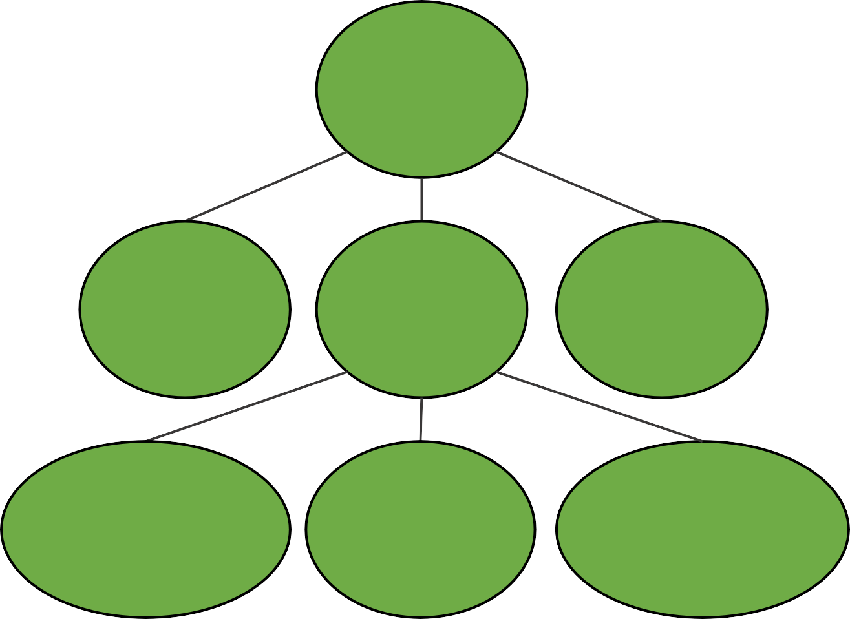
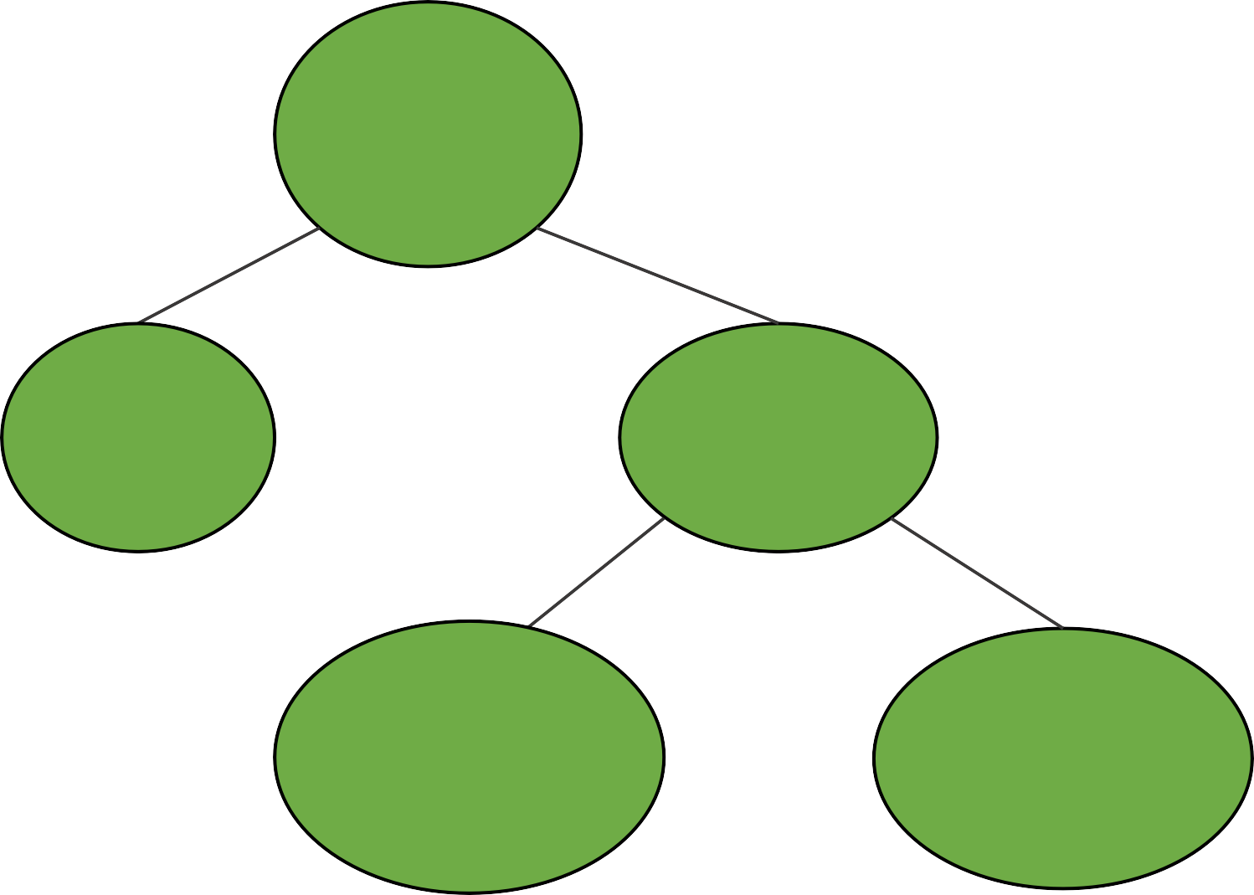
Different Trees in Computer Science
House
clean
Root is most important (Heap)
Organized by character frequency (Huffman Tree)
Organized by node ordering (Search Trees)
Etc…
parent
Tywin
No
Yes
Tyrion
Cersei
children
Floor
Clean?
Jaime
Relax
No
Yes
Myrcella
Joffrey
children
of children
Wash
Windows
Sweep Floor
Tommen
Family Trees
Why trees?
Different Organizations → Different Trees
Decision Trees
/
Evaluate: 45 / (3 + 6)
/
/user/porter
Structure conveys information
45
+
etc/
users/
3
6
porter/
minnes/
alvarado/
Expression Trees
File System
Dynamic Data Structure
3

Slide 4
Defining Trees
has no parent node
root
What defines a tree?
Single root
Each node can have only one parent (except for root)
No cycles in a tree
Tywin
parent
only has one parent
Tyrion
Cersei
Jaime
child
Myrcella
Joffrey
Tommen
leaf
Which are trees?
nodes without children
Family Trees
A
root
✓
B
C
D
E
two roots
root
root
✓
✓
two
parents
✗
two
parents
✗
3 children (all leaves)
leaf
Cycle: two different paths
between a pair of nodes
4

Slide 5
Binary Trees
Generic Tree
Any Parent can have any number of children
Tywin
A general tree would just have a list for children
Tyrion
Cersei
Jaime
How would a general tree node differ?
Myrcella
Joffrey
Tommen
Binary Tree
Any node can have at most two children
A tree just needs a root node
root
Tywin
like the head and tail for linked list
How do we construct a tree?
Each node needs:
A value
A parent
A left child
A right child
Tyrion
Cersei
Like Linked Lists, Trees have a "Linked Structure"
Joffrey
Tommen
nodes are connected by references
5

Slide 6
Tree Node
Each node represents a key/value pair.
public class Node<K, V> {
K key;
V value;
Node<K, V> left;
Node<K, V> right;
}
For simplicity, we focus on keys and omit the values in the discussions
Keys determine where the nodes go
1
aqua
A node with key 1 and value “aqua”

Slide 7
Definitions
Root node: the single node with no parent at the top of the tree. Leaf node: a node with no children
Subtree: a node and all it descendants
Height of a tree: defined as the number of edges in the longest path from the root node to a leaf node.
A tree with only a root node has height of 0.
The trees below all have height of 2.
1
1
1
1
1
4
4
4
0
4
8
2
2
8
2
8
7

Slide 8
Full Binary Tree
A full binary tree with height h has total number of leaves 2^{h}, and total number of nodes: n = 2^{h+1}−1
In a full binary tree, each level is completely filled. The number of nodes at each level l is 2^{l}. Therefore, the total number of nodes is the sum of nodes at all levels from 0 to h, which is a geometric series: n=1+2+4+…+2^{h}=2^{h+1}-1
This means that for a full binary tree, the total number of nodes grows exponentially with the height of the tree
h=0: n=2¹−1=1
h=1: n=2²−1=3
h=2: n=2³−1=7
1
4
0
4
1
2
8
-2
0.5
2
8
h=0
h=1
h=2
8
Notes:
A full binary tree with height hh has a total number of nodes given by the formula:2h+1−12h+1−1
This formula arises because, in a full binary tree, each level is completely filled. The number of nodes at each level ll is 2l2l. Therefore, the total number of nodes is the sum of nodes at all levels from 0 to hh, which is a geometric series:1+2+4+…+2h=2h+1−11+2+4+…+2h=2h+1−1
This means that for a full binary tree, the total number of nodes grows exponentially with the height of the tree1
3
.
Share
Rewrite

Slide 9
Height of a Binary Tree
For a binary tree with n nodes, the height h is bounded by: ⌈log₂(n+1)⌉ - 1 ≤ h ≤ n - 1
The lower bound represents a perfectly balanced tree, and the upper bound represents a degenerate tree (essentially a linked list).
The minimum height of a binary tree with n nodes is ⌈log₂(n+1)⌉ - 1, which occurs in the most balanced configuration, where ⌈⌉ is the ceiling operator, e.g., ⌈1.0⌉=1, ⌈1.3⌉=2.
The maximum height of a binary tree with n nodes is n-1, which occurs in the case of a skewed tree (a linear chain or linked list).
9
Notes:
The height of a tree is equivalent to the maximum depth of any node in the tree.

Slide 10

Tree Traversal - Motivation
Warning: These first examples are really graphs. We'll visit graphs in detail in the next course. Here they are used as motivating examples
start
Imagine this is a hedge maze
Strategy: go until hit a dead end, then retrace steps and try again
What's my next step?
Mazes benefit from "Depth First Traversals"
Bottom line: Order we visit matters and we'll make choices based on our needs
finish
Maze Traversal
E
A
B
Suppose you have a list of your friends and each of your friends have lists
F
you
How closely are you connected with D?
C
D
What's my next step?
Strategy: look at all of your friends first, and then branch out.
This problem benefits from "Breadth First Traversals"
Social Network
10

Slide 11
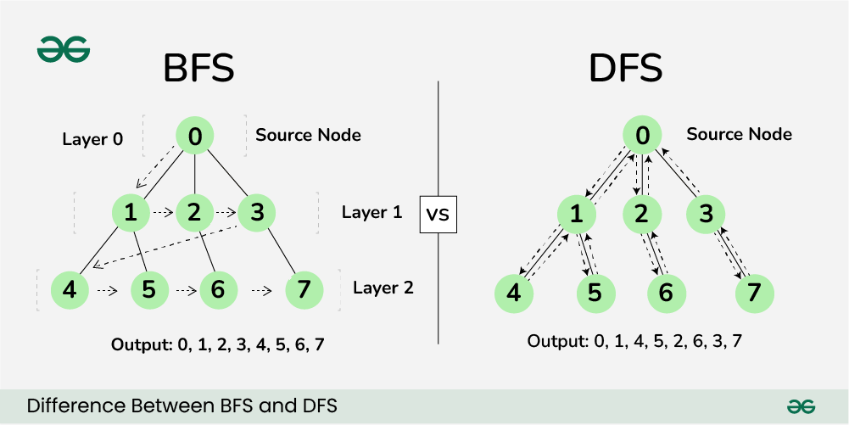
BFS vs. DFS
Breadth-First Search (BFS) and Depth-First Search (DFS) are two fundamental algorithms used for traversing or searching graphs and trees
BFS traversal explores all the neighboring nodes at the present depth prior to moving on to the nodes at the next depth level.
DFS uses backtracking. The deepest node is visited and then backtracks to its parent node if no sibling of that node exists
Breadth First Search (BFS) Animations https://www.youtube.com/watch?v=QUfEOCOEKkc
Depth First Search (DFS) Animations
https://www.youtube.com/watch?v=3_NMDJkmvLo
11

Slide 12
Traversal Order for Binary Trees
Breadth First Traversal with BFS
Level Order Traversal
Depth First Traversals with DFS
Pre-order Traversal (Root-Left-Right)
In-order Traversal (Left-Root-Right)
Post-order Traversal (Left-Right-Root)
12

Slide 13
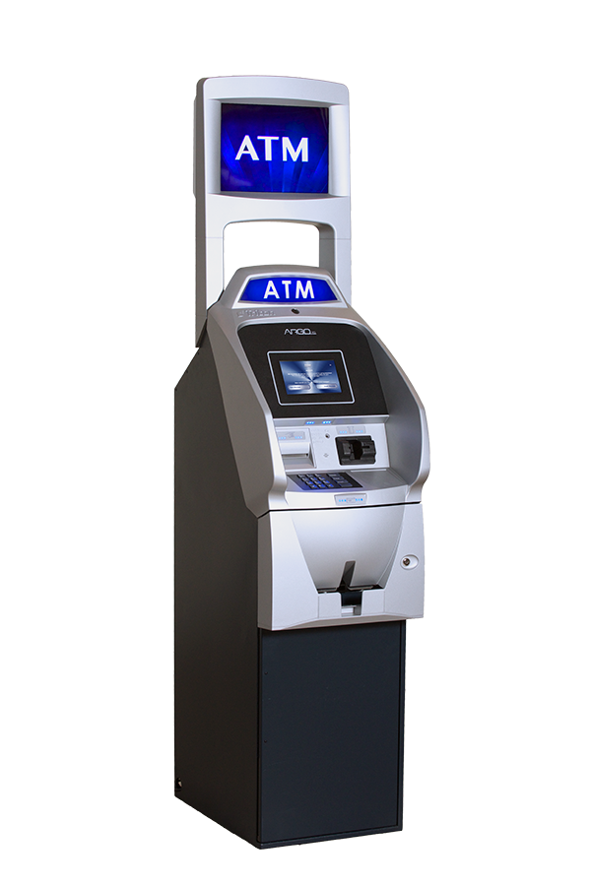
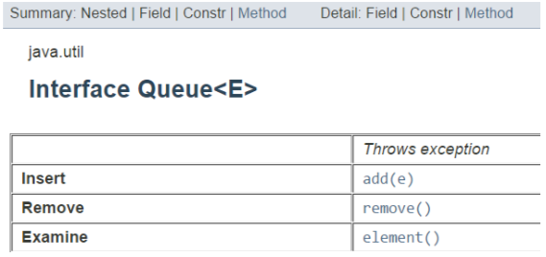
Graph Traversal with BFS: Level-order Traversal (Contd.)
Visit:
A
A
B
C
D
E
F
G
Challenging: When we finish B, how do we go to C next?
B
C
D
E
F
G
Idea: Keep a list and keep adding to it and removing from start.
Visit:
A
B
C
D
E
F
G
List:
A
B
C
D
E
F
G
We used this list like a "Queue"
Add to the end
Remove from the front
First-In, First-Out (FIFO)
look at the first element
13

Slide 14
Tree traversals with DFS: pre-order, in-order, post-order
function preOrderTraversal(node) {
if (node !== null) {
visitNode(node);
preOrderTraversal(node.left);
preOrderTraversal(node.right);
}
}
function inOrderTraversal(node) {
if (node !== null) {
inOrderTraversal(node.left);
visitNode(node);
inOrderTraversal(node.right);
}
}
function postOrderTraversal(node) {
if (node !== null) {
postOrderTraversal(node.left);
postOrderTraversal(node.right);
visitNode(node);
}
}
abcdef
cbdaef
cdbfea
Preorder Traversal in Binary Tree Animations https://www.youtube.com/watch?v=gLx7Px7IEzg
Inorder Traversal in Binary Tree Animations
https://www.youtube.com/watch?v=ne5oOmYdWGw
Postorder Traversal in Binary Tree Animations
https://www.youtube.com/watch?v=a8kmbuNm8Uo
14
Notes:
https://skilled.dev/course/tree-traversal-in-order-pre-order-post-order

Slide 15
Summary of Tree Traversals with DFS
Pre-order traversal:
Visit the node itself.
Traverse the left subtree.
Traverse the right subtree.
Begins at the root, ends at the right-most node.
In-order traversal:
Traverse the left subtree.
Visit the node itself.
Traverse the right subtree.
Begins at the left-most node, ends at the rightmost node.
Post-order traversal:
Traverse the left subtree.
Traverse the right subtree.
Visit the node itself.
Begins with the left-most node, ends with the root.
15

Slide 16
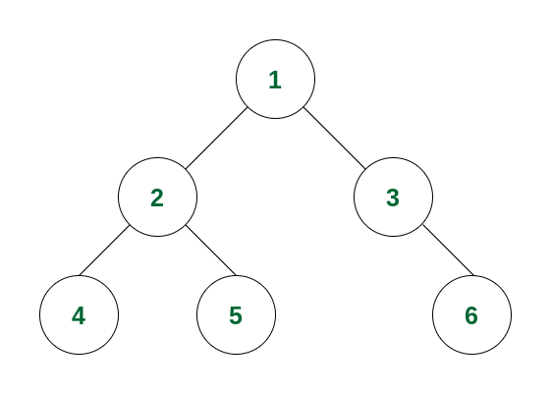
Geeks for Geeks Tutorials
https://www.geeksforgeeks.org/bfs-vs-dfs-binary-tree/
https://www.geeksforgeeks.org/preorder-traversal-of-binary-tree/
https://www.geeksforgeeks.org/inorder-traversal-of-binary-tree/
https://www.geeksforgeeks.org/postorder-traversal-of-binary-tree/
Running Example
16

Slide 17
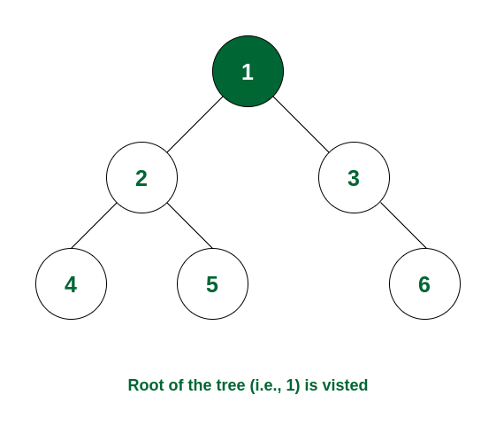
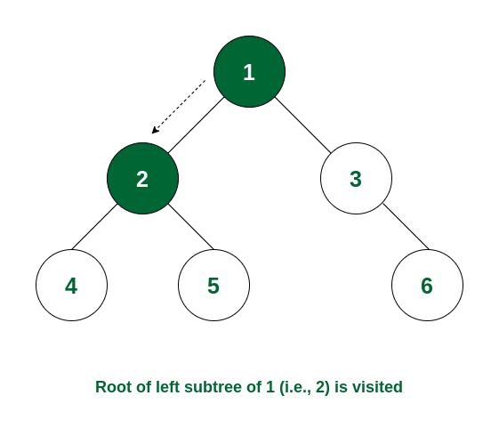
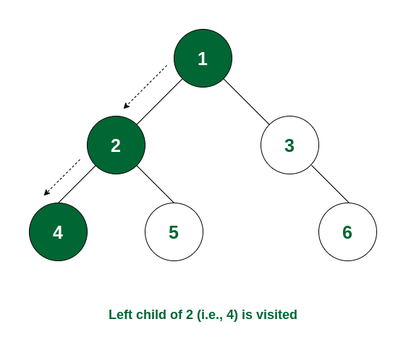
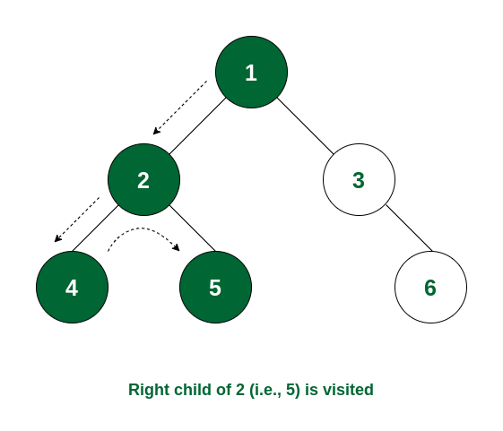
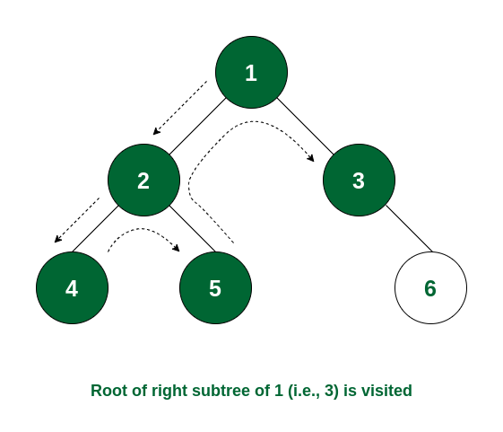
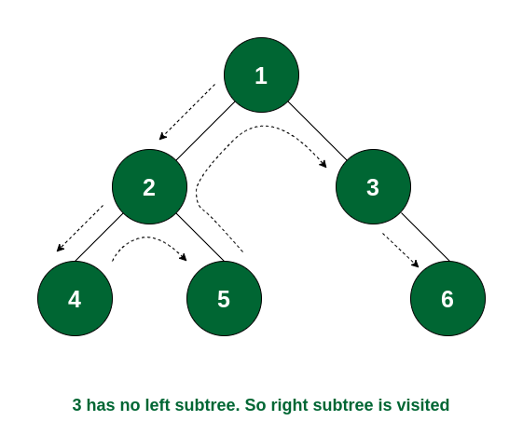
Pre-order traversal of nodes is 1 -> 2 -> 4 -> 5 -> 3 -> 6
17

Slide 18
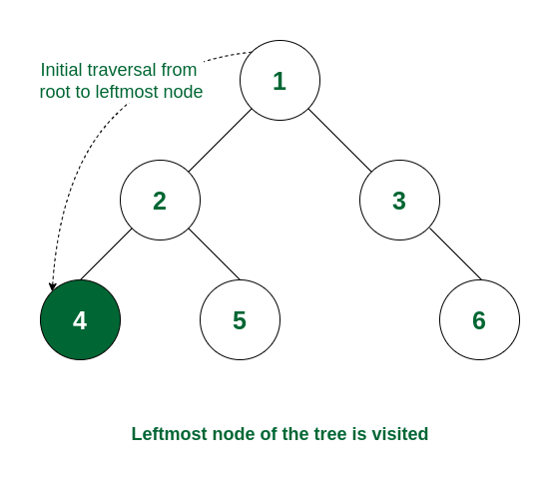
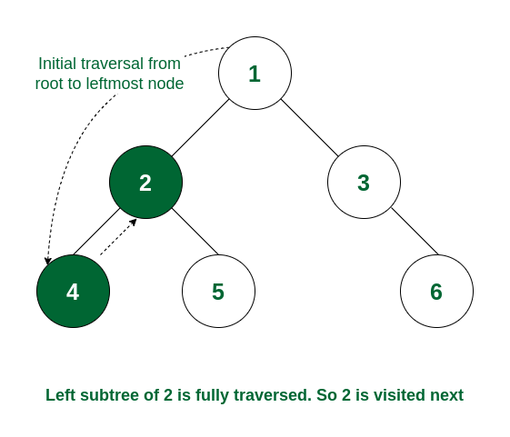
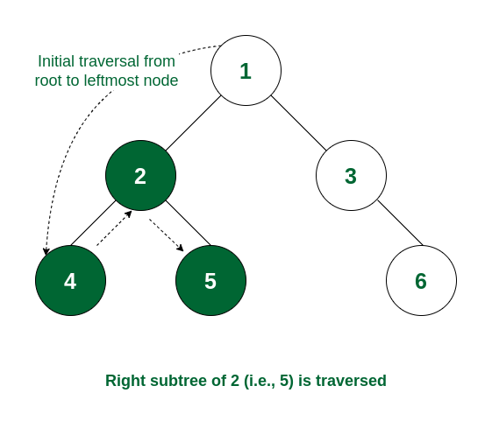
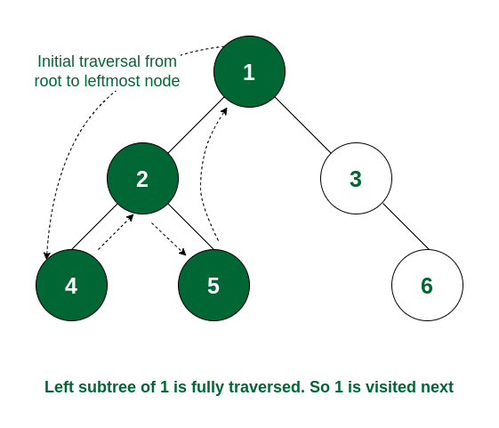
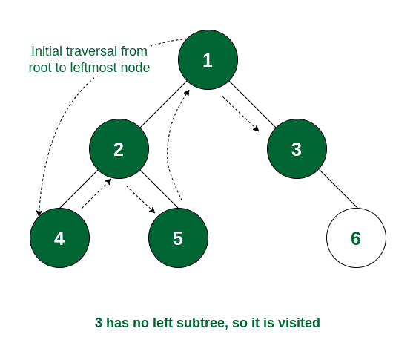
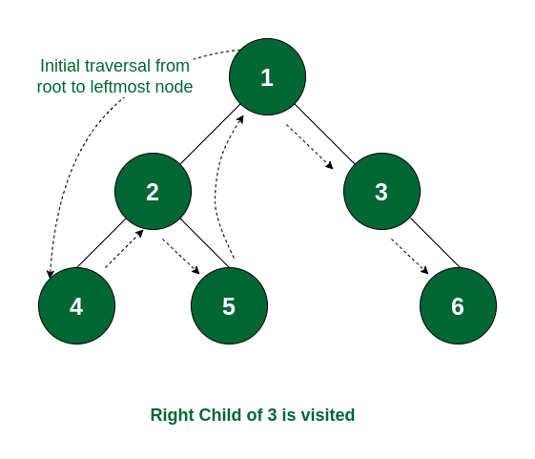
In-order traversal of nodes is 4 -> 2 -> 5 -> 1 -> 3 -> 6.
18

Slide 19
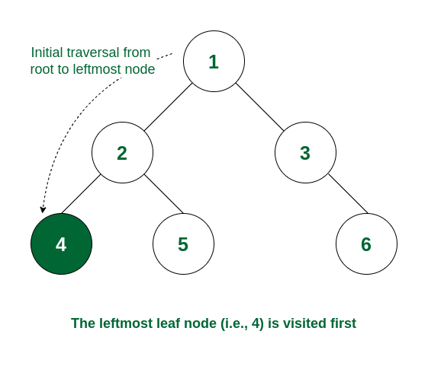
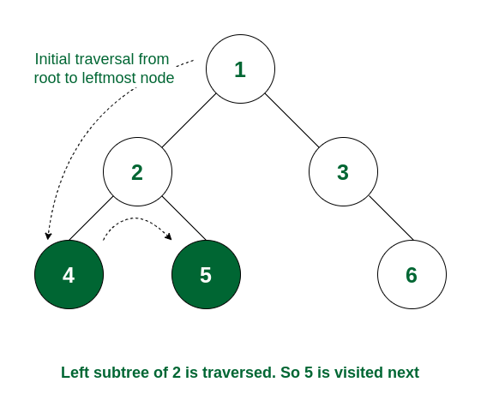
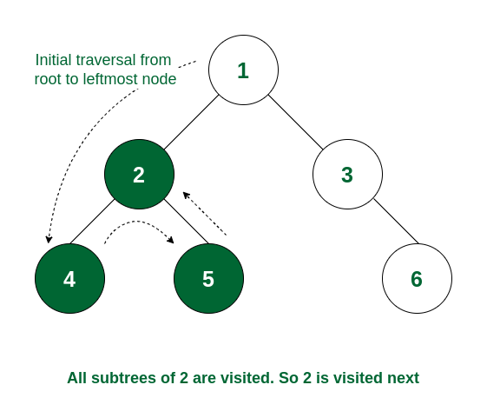
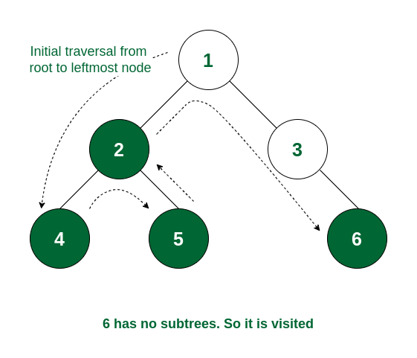
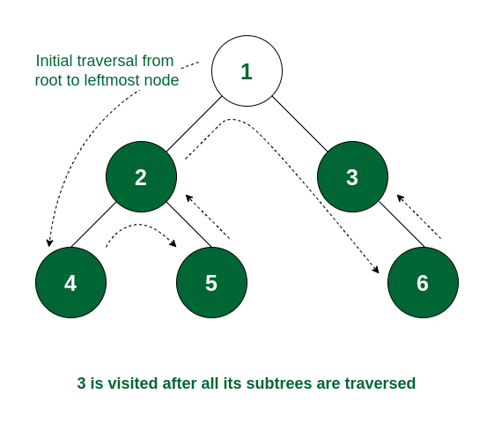

Post-order traversal of nodes is 4 -> 5 -> 2 -> 6 -> 3 -> 1
19

Slide 20
Motivation for Binary Search Tree
Agra
Beijing
Chicago
Essen
Lagos
Montreal
Quito
Binary Search - O(logn) search: get rid of half each time
toFind
Chicago
Sorted arrays are good for search, but bad for insertion/removal
root
So now we can do the same kind of fast searching we did within an array, but we can also get the benefit of a fast insert and a fast removal that a tree provides.
Essen
Beijing
Montreal
Agra
Chicago
Lagos
Quito
20

Slide 21
Binary Search Tree (BST)
A BST is an ordered, or sorted, binary tree, with the following invariants:
For every node with key k:
The left subtree has only keys smaller than k
The right subtree has only keys greater than k
This invariant applies recursively throughout tree
9
3
10
1
5
30
< 9
> 9
< 9
> 9
9
9
3
10
3
10
1
5
30
1
5
30
< 3 & < 9
> 3 & < 9
> 9 & > 10
Binary Search Tree Animations | Data Structure | Visual How
https://www.youtube.com/watch?v=ymGjUOiR8Jg
21

Slide 22
Searching for a Key: Binary Tree vs. Binary Search Tree
public boolean containsKeyBT(node, key) {
if (node == null) {
return false;
} else if (node.key == key) {
return true;
} else {
return containsKeyBT(node.left)|| containsKeyBT(node.right);
}
}
public boolean containsKeyBST(node, key) {
if (node == null) {
return false;
} else if (node.key == key) {
return true;
} else {
if (key <= node.key) {
return containsKeyBST(node.left);
} else {
return containsKeyBST(node.right);
}
}
}
* explores left, if not found then explores right
* explores either left or right at each level
Best Case:
finds value at overallRoot (random value)
Worst Case:
doesn’t find value, has to check every node
Best Case:
finds value at overallRoot (middle value)
Worst Case:
doesn’t find value, has to check one path
22

Slide 23
Searching a BST
E
Same fundamental idea as binary search of an array
B
M
toFind
C
Found it!
A
C
L
Q
Compare: E and C
Compare: B and C
Compare: C and C
toFind
P
How to implement this?
Compare: E and P
You could solve this with recursion.
Compare: M and P
Compare: Q and P
You could also solve it with iteration by keeping track of your current node.
Node is null
Not Found!
23

Slide 24
Searching a BST Iteratively
public class BinaryTree<E> {
TreeNode<E> root;
public boolean search(E toSearch) {
TreeNode<E> curr = root;
while (curr != null) {
if (toSearch < curr.getValue())
curr = curr.getLeftChild();
else if (toSearch > curr.getValue())
curr = curr.getRightChild();
else
return true;
}
return false;
}
}
It means that either the class E itself or one of its super classes implements Comparable
<E extends Comparable<? super E>> {
Do NOT change root pointer!
Doesn’t work with objects
while (curr != null) {
int comp = toSearch.compareTo(curr.getValue());
if (comp < 0)
curr = curr.getLeftChild();
else if (comp > 0)
curr = curr.getRightChild();
else // comp = 0
return true;
}
We need to do this over and over if not found
if calling object is less than parameter,
compareTo returns a value < 0
Are we done?
if calling object is greater than parameter, compareTo returns a value > 0
root
E
curr
t.search(’L’)
if calling object is equal to parameter, compareTo returns 0
B
M
Traverse down tree until:
end is reached
element is found
A
C
L
Q
24

Slide 25
Searching a BST Recursively
public class BinaryTree<E extends Comparable<? super E>> {
TreeNode<E> root;
private boolean search(TreeNode<E> p, E toSearch) {
if (p == null)
return false;
int comp = toSearch.compareTo(p.getValue());
if (comp == 0)
return true;
else if (comp < 0)
return search(p.left, toSearch);
else // comp > 0
return search(p.right, toSearch);
}
public boolean search(E toSearch) {
return search(root, toSearch);
}
}
Root of the tree we look at
Tree is empty
Found it!
look left
look right
root
E
p
B
M
t.search(’L’)
A
C
L
Q
25

Slide 26
Insertion into a BST
Run BST search algo, traverse down tree until end is reached, then insert it into that position.
20
20
Insert 7
10
30
10
30
5
25
5
25
Insert 27
7
20
20
10
30
10
30
5
25
5
25
Insert 8
✓
7
27
✓
7
27
8
26

Slide 27
Deletion from a BST
20
20
10
30
Delete 7
10
30
5
25
If leaf node: delete it directly
5
15
25
15
7
12
12
20
20
10
30
Delete 5
10
30
5
25
7
15
25
15
If only one child:
hoist child
7
12
12
27

Slide 28
Deletion from a BST
Two alternatives when a deleted node has two children.
20
20
10
30
Delete 10
12
30
5
25
1) Find smallest value in right subtree (12). Replace deleted element with it, then delete right subtree duplicate.
5
15
25
15
7
12
7
20
20
10
30
Delete 10
7
30
5
25
2) Find largest value in left subtree (7). Replace deleted element with it, then delete left subtree duplicate.
5
15
25
15
7
12
12
28
Notes:
Find smallest value in right subtree. Replace deleted element with it, then delete right subtree duplicate.
Find largest value in left subtree. Replace deleted element with it, then delete left subtree duplicate.

Slide 29
Binary Search Tree Shape
The following are all valid BSTs resulting from adding elements: 1, 2, 4, and 8 in some order.
The order in which we put elements into a BST impacts the shape, and the shape of a BST has a huge impact on the performance of operations.
A
B
C
D
1
2
1
2
2
1
8
4
1
4
4
8
4
2
8
8
29
Notes:
For valid trees, determine (on your own) an insertion order which would produce that tree?

Slide 30
Binary Search Tree Shape (Contd.)
A
✓
Inserting a node means making it a child of an existing node
Insert nodes as leaves
2
Root comes first
2
2
4
1
8
1
4
2
1
4
8
8
2
4
8
1
8 needs to be inserted AFTER 4
B
✓
2
2
Root comes first
2
8
1
4
2
1
8
4
1
8
2
8
4
1
4
4 needs to be inserted AFTER 8
30

Slide 31
Binary Search Tree Shape (Contd.)
C
1
Root comes first
1
2
Needs to be inserted AFTER 1
1
2
1
2
4
4
Needs to be inserted AFTER 2
1
2
4
8
✓
8
Needs to be inserted AFTER 4
D
✓
1
1
Root comes first
1
4
4
Needs to be inserted AFTER 4
1
4
2
8
1
4
8
2
2
8
Both 2 and 8 needs to be inserted AFTER 4
31

Slide 32
Traversal of a BST: Example I
When we perform in-order traversal on a binary search tree, we get the ascending order array.
Pre-order traversal:
Traversal sequence: 30, 10, 25, 18, 23, 27, 70, 60, 80
In-order traversal:
Traversal Sequence: 10, 18, 23, 25, 27, 30, 60, 70, 80
Post-order traversal:
Traversal sequence: 23, 18, 27, 25, 10, 60, 80, 70, 30
30
10
70
25
60
80
18
27
23
32
Notes:
Post-order traversal is 23, 18, 27, 25, 10, 60, 80, 70, 30.
In-order traversal traversal is 10, 18, 23, 25, 27, 30, 60, 70, 80
Preorder traversal is 30, 10, 25, 18, 23, 27, 70, 60,80
https://testbook.com/objective-questions/mcq-on-tree-traversal--5eea6a1139140f30f369eb98

Slide 33
Traversal of a BST: Example II
Pre-order traversal:
Begins at the root (7), ends at the right-most node (10)
Traversal sequence: 7, 1, 0, 3, 2, 5, 4, 6, 9, 8, 10
In-order traversal:
Begins at the left-most node (0), ends at the rightmost node (10)
Traversal Sequence: 0, 1, 2, 3, 4, 5, 6, 7, 8, 9, 10
Post-order traversal:
Begins with the left-most node (0), ends at the root (7)
Traversal sequence: 0, 2, 4, 6, 5, 3, 1, 8, 10, 9, 7
7
1
9
0
3
8
10
2
5
4
6
33
Notes:
https://stackoverflow.com/questions/9456937/when-to-use-preorder-postorder-and-inorder-binary-search-tree-traversal-strate

Slide 34
In-Order Traversal of a BST
In-order traversal of a BST visits the nodes in ascending order of their values, i.e., from smallest to largest.
BST Property: In a BST, for any given node:
Values in the left subtree are less than the value of the node.
Values in the right subtree are greater than the value of the node.
In-order Traversal:
Traverse the left subtree.
Visit the node itself.
Traverse the right subtree.
Resulting Order: By first visiting all nodes in the left subtree (which are smaller), then the root, and finally all nodes in the right subtree (which are larger), in-order traversal naturally outputs the nodes in non-decreasing order.
This property makes in-order traversal particularly useful for retrieving data from a BST in sorted order.
34
Notes:
Citations:
[1] https://www.codecademy.com/resources/docs/general/binary-search-tree/inorder-traversal
[2] https://www.geeksforgeeks.org/tree-traversals-inorder-preorder-and-postorder/
[3] https://www.geeksforgeeks.org/binary-search-tree-traversal-inorder-preorder-post-order/
[4] https://www.freecodecamp.org/news/binary-search-tree-what-is-it/
[5] https://en.wikipedia.org/wiki/Binary_Search_Tree
[6] https://www.enjoyalgorithms.com/blog/introduction-to-binary-search-tree/

Slide 35
Performance Analysis of BST
Storing a dictionary as a BST
{ am, at, ate, ear, eat, east }
Structure of a BST depends on the order of insertion
containsKey(root, east)
4
east
Best case: O(1)
ate
3
at
eat
at
east
am
ate
Compared with 3 out of 7 words
am
ear
eat
ear
How does the performance scale with input size n?
Performance also depends on the actual structure of the BST
eat
public boolean containsKey(node, key) {
if (node == null) {
return false;
} else if (node.key == key) {
return true;
} else {
if (key <= node.key) {
return containsKey(node.left);
} else {
return containsKey(node.right);
}
}
}
east
6
ear
ate
at
am
Compared with all 7 words
35

Slide 36
AVL Tree
AVL Tree: A balanced BST that maintains the invariant: |LeftHeight – RightHeight | <= 1 for all nodes in the tree. It minimizes the BST height. (discussed in next lecture.)
node
ate
at
east
Left
Height
Right
Height
am
ear
eat
height ≈ log(n)
Inserting elements into BST in order results in a linked list!
 | Best case | Average case | Worst case
Linked List | O(1) | O(n) | O(n)
BST | O(1) | O(log n) | O(n)
AVL Tree | O(1) | O(log n) | O(log n)
containsKey(root, key)
36
Notes:
A balanced BST maintains the invariant |LeftHeight – RightHeight | <=1 for all nodes in the tree.
BST height dictates the number of recursive calls needed during search, hence smaller height

Slide 37
BST vs. Hash Table
Time Complexity
Average case:
Hash Tables generally offer O(1) average time complexity for insertion, deletion, and search operations.
BSTs provide O(log n) time complexity for these operations, assuming the tree is balanced.
Worst case
Hash Tables can degrade to O(n) performance in cases of poor hash function design or many collisions.
BSTs maintain O(log n) performance even in the worst-case for self-balancing BST.
Ordered Operations
BSTs excel at operations requiring ordered data
In-order traversal yields sorted elements.
Efficient range searches (e.g., finding all keys within a range)
Hash Tables do not inherently maintain order, making these operations more difficult.
37
Notes:
Advantages of BST over Hash Table | GeeksforGeeks
Time complexity for Search, Insert, Delete operations is O(1) for Hash Table, O(log n) for Self-Balancing BST
BST advantages:
1. Can get all keys in sorted order by In-Order Traversal of BST
2. Order statistics, finding closest lower and greater elements, doing range queries, are easy to do with BSTs
3. With Self Balancing BSTs, all operations are guaranteed to work in O(logn) time

Slide 38
Video Tutorials
Tree Traversal Algos // Michael Sambol
https://www.youtube.com/playlist?list=PL9xmBV_5YoZO1JC2RgEi04nLy6D-rKk6b
Binary Search Tree : Overview
https://www.youtube.com/watch?v=6I3evyt9ApA
Binary Search Tree : Insert Overview
https://www.youtube.com/watch?v=KkEnuK-2Ymc
Binary Search Tree: Deletion Overview
https://www.youtube.com/watch?v=DkOswl0k7s4
Binary Search Tree Removal
https://www.youtube.com/watch?v=8K7EO7s_iFE
Binary Search Trees (BST) Explained in Animated Demo
https://www.youtube.com/watch?v=mtvbVLK5xDQ
38
Notes:
Pre-order Traversal Algorithm | Tree Traversal | Visualization, Code, Example
https://www.youtube.com/watch?v=8xue-ZBlTKQ
In-order Traversal Algorithm | Tree Traversal | Visualization, Code, Example
https://www.youtube.com/watch?v=4_UDUj1j1KQ
Post-order Traversal Algorithm | Tree Traversal | Visualization, Code, Example
https://www.youtube.com/watch?v=4Xo-GtBiQN0

